Slide 1


Slide 2


Slide 3
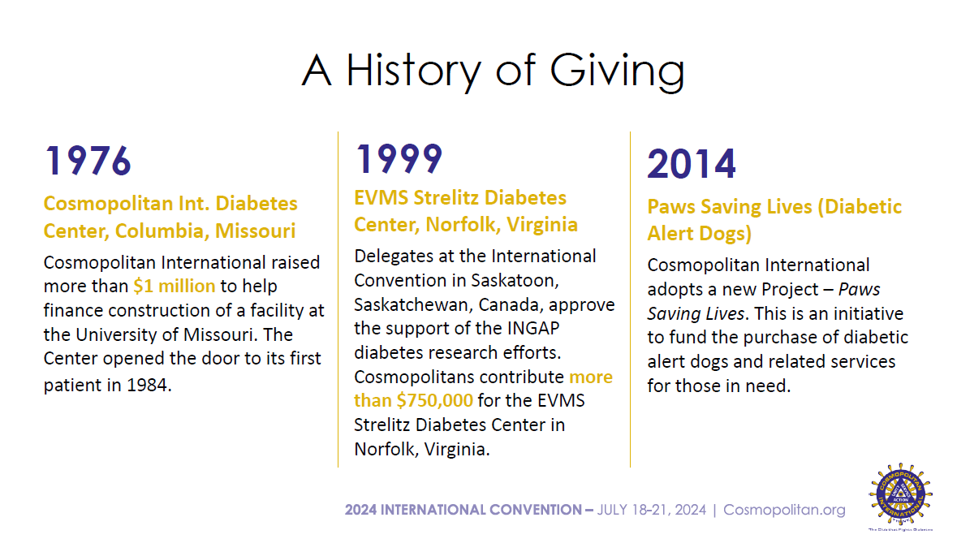

Slide 4
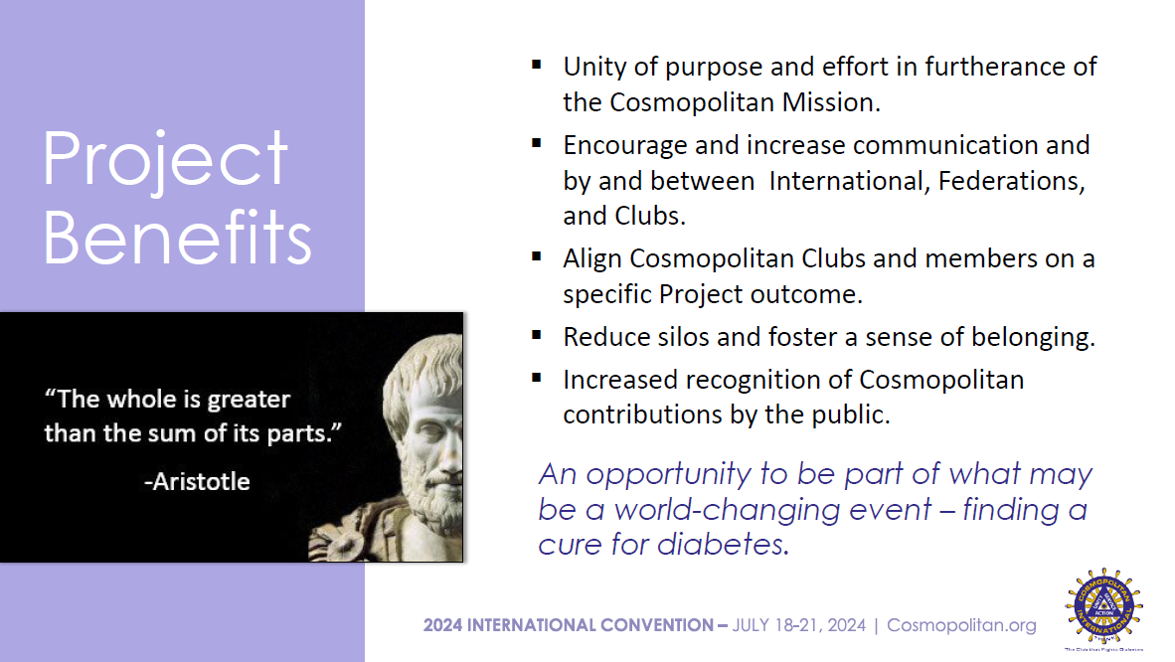

Slide 5


Slide 6


Slide 7
Fundraising Goal
CONTRIBUTION | AMOUNT
Contribution over 5 Years | $1,000,000
Total Amount per Year | $200,000
Number of Cosmo Members | 1,085
Amount per Member per Year | $184
 | (Example ONLY)
Approved Funding Target
7.19.2024

Slide 8
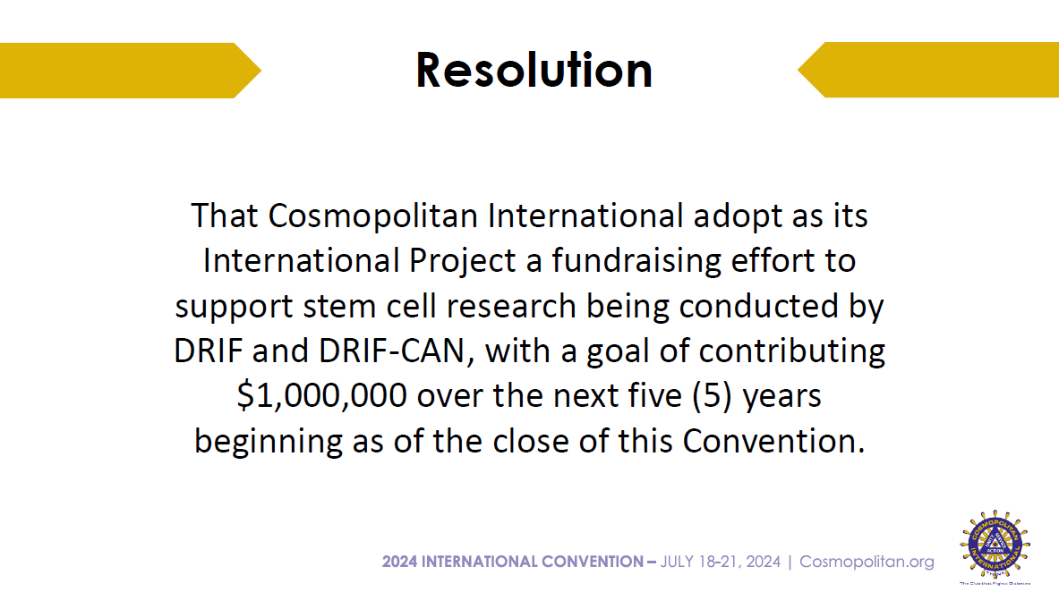

Slide 9

Why Should I support the International Project?
Consistent with Our Mission to Help Find a Cure for Diabetes.
Its an Opportunity for Us to Help Finish Something We Helped Start.
Its Possible That Combining the Fund Raising of All Our Clubs Can Increase the Efficiency of the Research.

Slide 10
Here is what has happened to date…
Non- insulin producing cells from the pancreas have been converted to insulin producing cells.
Stem cells have been engineered to become insulin producing islets in the lab.
Engineered stem cells have been injected into mice and non-human primates and have successfully started producing insulin.
Research is ongoing as to where is the best place to inject the engineered stem cells into the body.

Slide 11
Here is what has happened to date…
Stem cells have been injected into Type 1 and type 2 diabetics in China with early results showing that the pancreases are now producing insulin. Further research on the variants involved in this research are underway.
Similar studies have begun elsewhere, including Edmonton and Miami. Most are still using immunosuppressants for safety.

Slide 12
What are the next steps?
The success of the stem cell transplants in China must be peer reviewed and duplicated.
Engineered stem cells will have to be successfully transplanted without the use of immunosuppressants.
Human trails will have to be successfully conducted.
Human trials are expected to begin during the life of the International Project; some as soon as next year.

Slide 13

Are There Benefits for Our Organization?
It could Help Recreate the Feeling Among Our Clubs that We are All a Part of the Same Team and thereby Strengthen Our Organization.
It could Help with Membership and Public Recognition.
It could Improve Communication within Our Organization as We Report Our Success.

Slide 14
Project Implementation?
The Project is for a period of five years beginning in 2024.
Participation by a Club is completely voluntary. The hope is that Clubs contribute to the International Project as a part of their overall fundraising in combination with individual giving.
There is NO expectation that Clubs must completely forego their customary programs in favor of the International Project.
There is NO quota, mandate, or benchmark that individual members or Clubs are expected to meet although International would like to establish a fundraising goal for the Project.
The emphasis is on collective effort and participation over specific monetary targets for individuals and Clubs.

Slide 15
Progress To Date
PROJECT COMMITTEE. Form a Project Committee task with managing all aspects of the International Project. (Membership is open, volunteer today.)
DEVELOP A PROJECT STRATEGY. The Committee will adopt an overall Project Strategy including promotional materials to members, a timeline for the Project including ongoing communication to members and Clubs and regular meeting dates, and defining a process for collecting contributions and distributing those amounts to DRIF/DRIF-CAN.
ENGAGE DRIF AND DRIF-CAN. Meet with DRIF and DRIFCan to coordinate the Project plan and to encourage by those organizations of the Cosmopolitan Project.
PROJECT KICKOFF. Officially launch the Project with a press release and accompanying Club communication.

Slide 16


